Slide 1
Good practice examples of accessible rolling stock (DB, SNCF, NS)
Blaž Pongračič, Senior Policy Adviser Passenger
Towards independent and spontaneous rail travel for all
27 May 2021 - Online Conference

Slide 2
Topics
Digital solutions
Access to trains
Amenities on board
Cooperation with association
Notes:
All the products are developed by the national associations and employees that are experts or are PRM.

Slide 3
Before we start

Slide 4
1
Digital solutions

Slide 5
DB - Bahnhof Live App

Slide 6
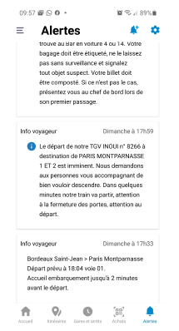
SNCF
DIGITAL SOLUTION TO PROVIDE TRIP INFORMATION TO DEAF PEOPLE IN TRAINS WITHOUT VISUAL INFORMATION SYSTEM

Slide 7
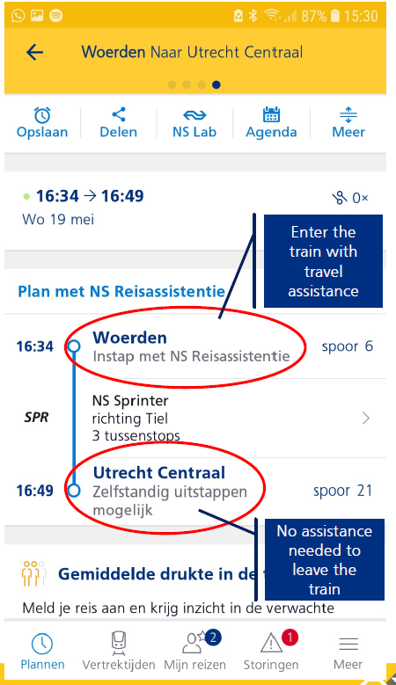
NS

Slide 8
2
Access to trains

Slide 9
Travelling without advance booking: possible on trains with sliding step

Slide 10
Travelling without advance booking: possible on trains with sliding step

Slide 11
DB
84 % of 5.700 railway stations are stepless accessible
On average 100 railway stations p.a. re upgraded into accessible stations
16 mobile teams take care of safe boarding and-de-boarding

Slide 12
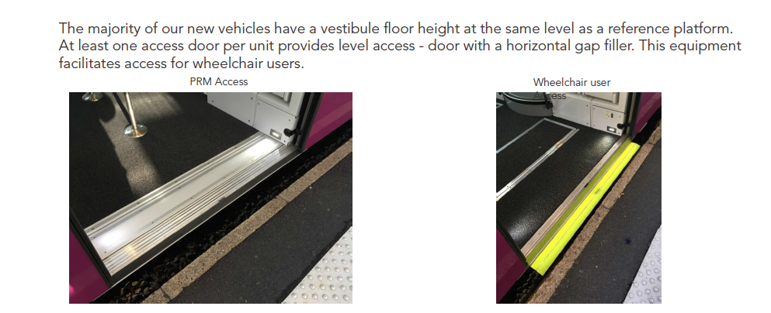
SNCF

Slide 13
3
Amenities on board

Slide 14
SNCF

Slide 15
DB
Tactile path and routing
Tactile seat numbers und handles at seats
Visual real-time information on monitors at the ceiling
Variable tables at wheelchair accessible seats
On newer vehicles acoustical signals to find door areas for customers with visual impairments
Vehicle bound ramps or lifts
Large suitcase stowage space on the floor or at lower level
Stepless and independent access to the new „ECx“Talgo trains (starting operations in 2023)

Slide 16
4
Cooperation with association

Slide 17
SNCF

Slide 18
Blaž Pongračič
Senior Policy Adviser Passenger
Tel: +32 (0) 460 75 79 57
E-mail: blaz.pongracic@cer.be

